Slide 1
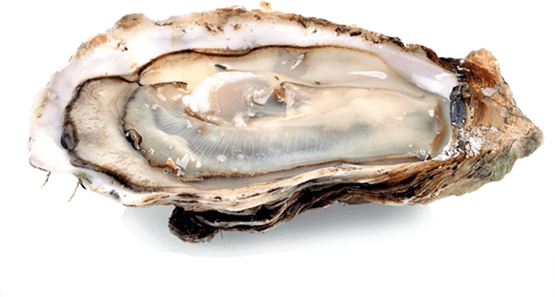
What seasonal trends can be seen between turbidity
and TDS_gL (total dissolved solids) and how does it affect the oysters' population?
Team 4: Cognitive Pythons
Ashley
Brandon
Kevin
Melissa
Aya
melissa

Slide 2

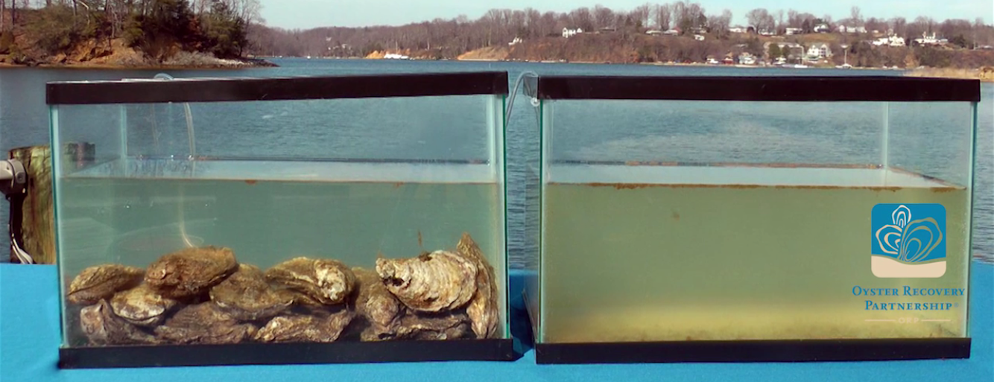
Purpose
We want to research this to examine oysters’ filtration and get a better understanding on how frequent they filter the water. This way we can know when oysters are productive in filtration and know when is the best time to treat oysters when their actions start to slow down/change.
Aya

Slide 3
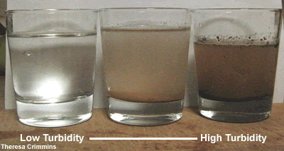
Our Guess/Hypothesis
Oysters filter water which uses the dissolved solids and algae as food source
Turbidity is defined as clarity in water
TDS would affect each other: TDS goes up and turbidity would go up = direct proportional relationship
Seasonally results would increase/decrease
Turbidity inhibits growth of plants and phytoplankton and degrades the environment, so higher turbidity would cause survival rate of oysters to decrease
melissa

Slide 4
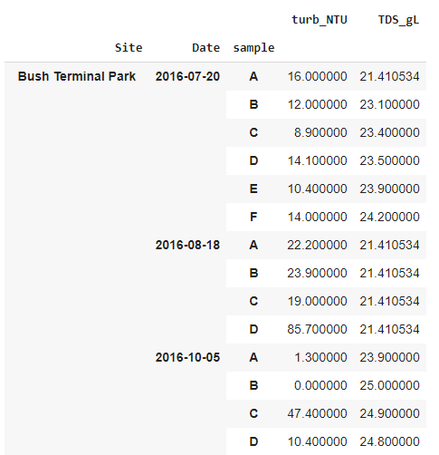
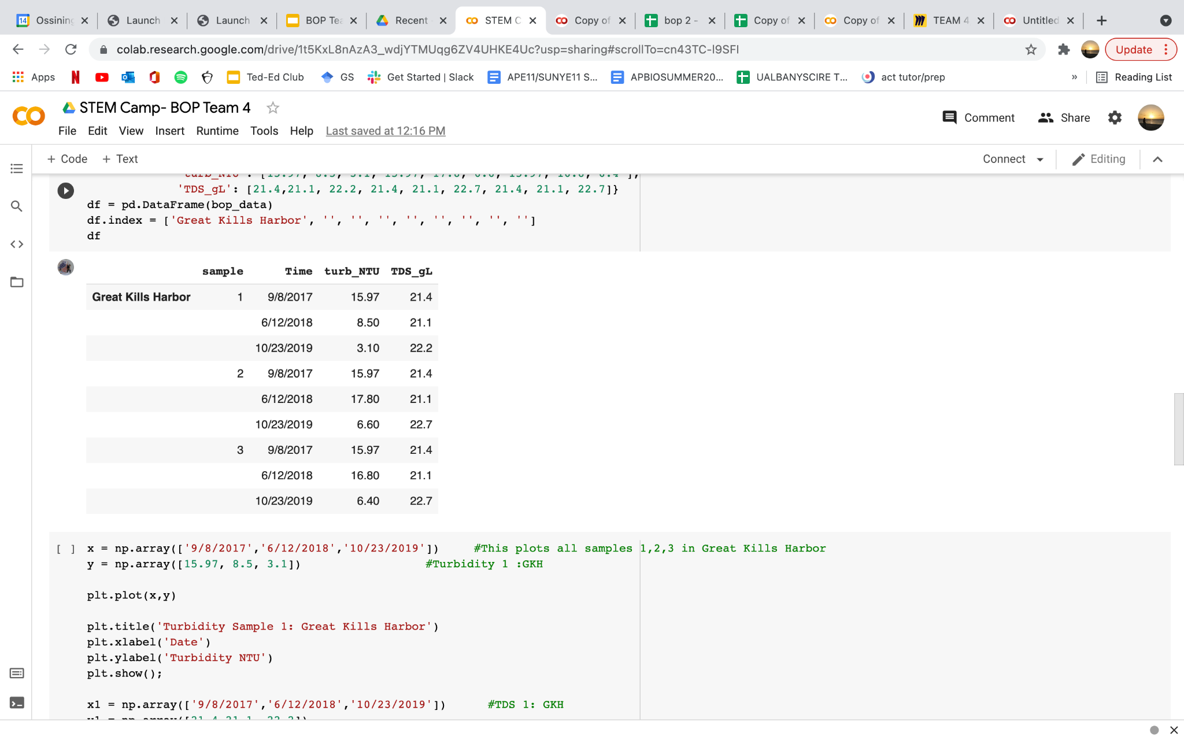
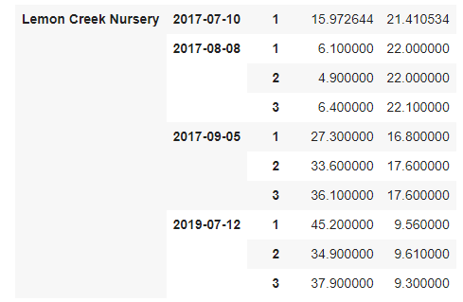
Data from BOP
We’ve gathered data on the two factors; Turbidity and Total Dissolved Solids. We chose three different sites and three different samples from each of the site to graph. We tried gathering different times from Summer of June-August to near late Fall in around October-November.
melissa

Slide 5
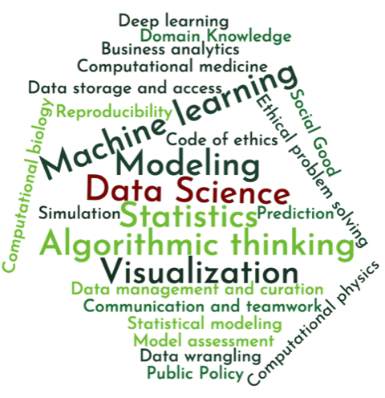
Data Science Process
The process of finding results in the data is not always easy. The first step is to ‘clean’ the data:
Filling in missing values
Making the labels formal
Combining data
After the data has been cleaned, it can be graphed. We can pick and choose a lot of the variables of the graphs:
Type of graph(s)
Title
Axes labels
Tick mark labels
Tick mark values
But for the most part when you’re just learning data science is about experimenting with the data and different ways to display it!
Aya

Slide 6
Correlation between turbidity, TDS, and seasons

Slide 7
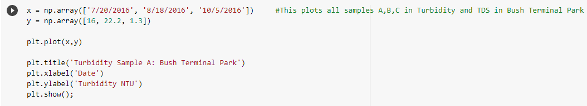
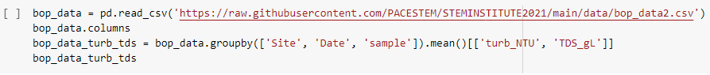
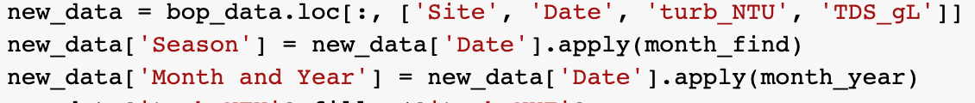
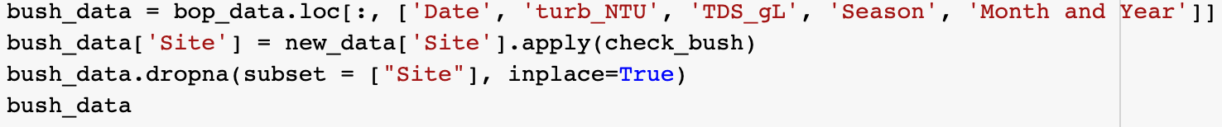
Python Code
The code below displays the method behind displaying the turbidity and TDS by grouping them under specific columns.
2) Above presents the process of graphing the values on a plot.
Dependent Variable(y): Turbidity, TDS
Independent Variable(x): Time
3) Below is the process of creating a subset of the general data. This was used both to divide the data into seasons (by applying a function over a column), and also into locations.
Brandon
Notes:
So our python code, number 1, below displays how we were able to get our data organized by having python read the csv document and tell it to group by site, date, sample, and then by turbidity and tds. Above number two displays how we graph that data. By setting an array with the values, time being x and turbidity and tds being y, we can create a plot or line chart. We can then copy and paste this code while inputting different values to get different graphs. Number 3 below displays another code creating graph, this time dividing the data in to seasons and location, giving a bar and scatter plot visualization.

Slide 8
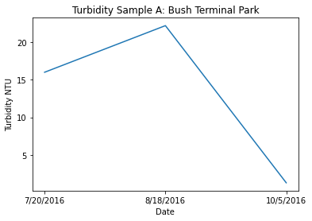
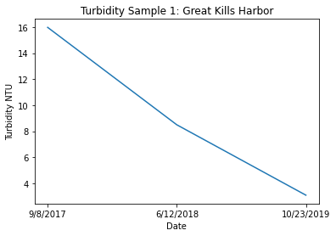
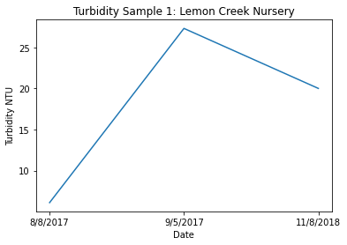
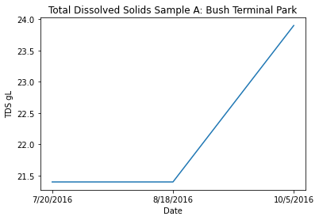
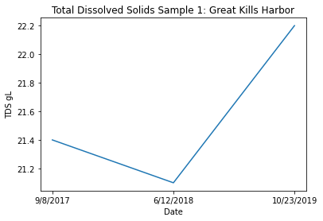
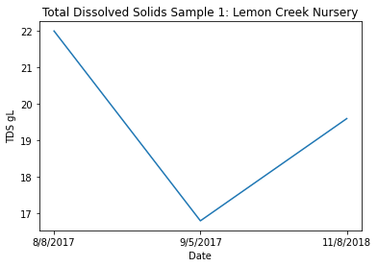
Graphs
Brandon
Notes:
In our notebooks, our code displayed here 18 different graphs for each factor, each of the three samples, and each location. We couldn’t fit all of them here though. But it you take a look and compare all of them, you can see a connection between turbidity and TDS; whenever turbidity increases, TDS will decrease, with the exception to Great Kills Harbor sample 1. You can also take a note that these trends occur during the transition from summer to fall.

Slide 9
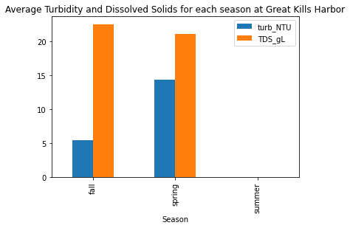
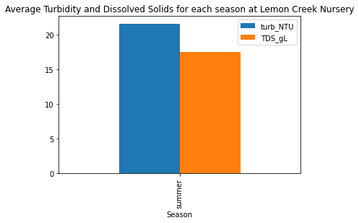
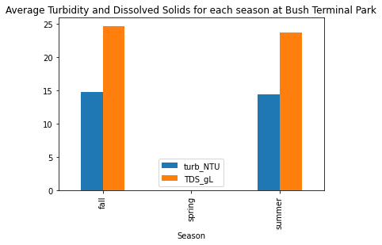
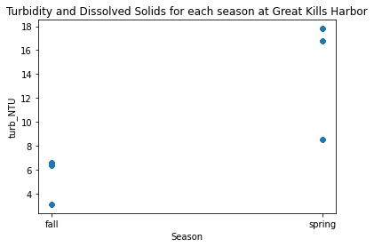
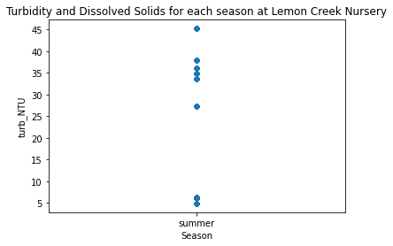
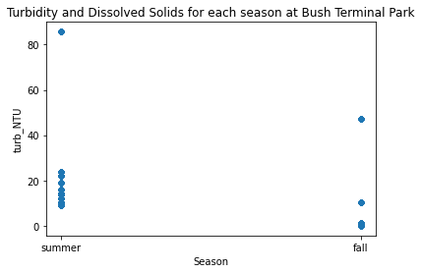
Aya
Notes:
Rather than just comparing the turbidity and total dissolved solids, these graphs also incorporate the seasons more distinctly. The different columns are bar and scatter graphs from the 3 different locations we chose to look at. It is important to note that the data that these graphs are using is not the same as from the other graphs, it’s a more complete representation of the data we were given. That said, due to the way the data was collected - mostly during the spring and summer - the amount of data from each season will vary wildly, so it is not a complete and fair representation.

Slide 10
Results
Results
We concluded from the given data that:
Turbidity varies inversely with Total Dissolved Solids (TDS).
As Turbidity decreases, TDS increases.
In specific a time, turbidity decreases when it reaches around fall
Turbidity levels are high during summer
**note: due to the way the data was collected there is no information for one or more seasons for each location and the quantity of data for each season is highly variable
Ashley
Notes:
Here, ….we learned, ….. Would possibly vary

Slide 11
Turbidity and TDS Impact on Survival
Notes:
The next factors that we observed were the impact of turbidity and tds on survival rates, which is the percentage of measured oysters still alive during the time of measurement.

Slide 12
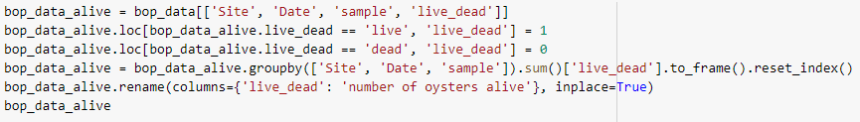
Python Code
Get number of oysters observed at the respective site, date and sample
2. Get number of oysters that were alive at the time of measurement.
3. Calculate the percentage of oysters alive
4. Merge everything together into one dataframe
Notes:
To do this, first we had to collect the necessary data. The first data that we collected was the number of oysters observed at their respective site, date and sample. Then we collected the number of oysters that were alive at the time of measurement. Next we calculated the the percentage of oysters alive by dividing the number observed oysters by the number of oysters alive. This gave us three dataframes, which we then merged it into the original dataframe with the information on turbidity and tds for visualization.

Slide 13
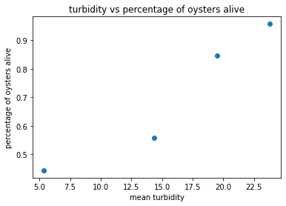
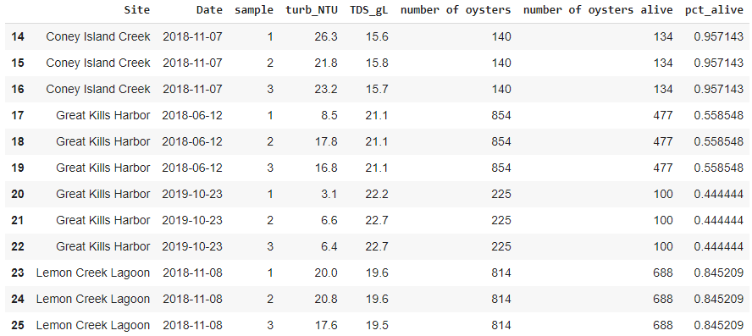
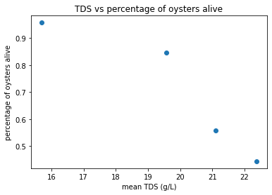
Results
As turbidity increases the percentage of oysters alive increases quadratically and as tds increases percentage of oysters alive decreases quadratically.
Notes:
Here are the results. On the left, you can see the final dataframe. Only index 14 - 25 of the dataframe are shown, because we don’t have data on number of alive or dead oysters for the other sites and samples. Since the number of oysters alive are the same throughout the day, we decided to take the mean of turbidity and tds. On the right, you can see the two plots. The mean of the two factors are the x-values as these are the independent variables and the percentage of oysters alive are plotted on the y-axis as this the dependent variable. What we can conclude from the visualization is that as turbidity increases the percentage of oysters alive increases quadratically and as tds increases percentage of oysters alive decreases quadratically.

Slide 14
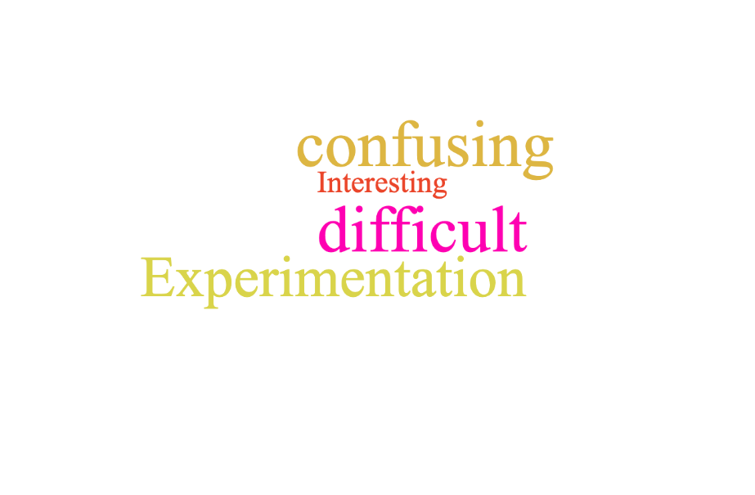
Discussion- Experiences using real data
Ashley
Notes:
Confusing -difficult - interesting (.python to navigate.)- experimentation (trial and error)....Thank you… Cognitive Pythons

